Slide 1

LEAD SCORING CASE STUDY
Pavan S

Slide 2
PROBLEM STATEMENT
X Education, an online education company for industry professionals markets its courses on websites and search engines. Once people land on these websites, they are asked to fill forms entering e-mail and phone number details or watch few videos, following they are classified as leads. After this, the marketing company follows up with these ‘leads’ through e-mails and calls, which results in the conversion of a few. The typical lead conversion rate at X education is around 30%. The company dedicates HR, capital resources for nurturing these leads, thereby underlining the importance of correctly identifying the ‘Hot leads’-leads with a high chance of conversion. The company needs a logistic regression model which is able to predict which leads are most likely to convert. The CEO has given a ballpark figure of 80 percent.

Slide 3
SOLUTION APPROACH
 Data Reading
 Data cleaning and Manipulation
 Dropping highly skewed columns
 Null Value check and replacement
 Regrouping values into categories which have more categories( > 15)
 EDA
 Univariate and Bivariate Analysis
 Data Preparation
 Dummy Variable Creation
 Test Train Split
 Feature Scaling
 Data Modelling
 Conclusion

Slide 4
DATA CLEANING AND MANIPULATION
 Replace ‘select’ values in dataframe with NaN
 Drop the columns which are highly skewed i.e. where the frequency of a single value is more than 90%. Even though ‘Do Not Mail’ has high skewed value we retain this due to business needs
 Check percentage of null values in columns and drop the columns which have more
than 45% missing values
 Replacing null values
 With the most frequent value in Lead Source and Lead Activity
 With already present values like Other , Unknown in remaining categorical columns
 With the median for the numerical columns Total Visits and Page Views per Visit
 Re-Categorizing the categorical columns (Lead Source , Last Activity , Country ,
Specialization) which have more number of categories > 15
 Outlier check was done and no outliers were done

Slide 5
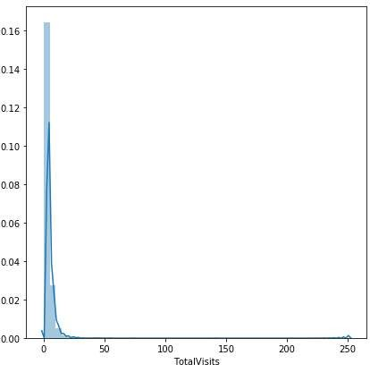
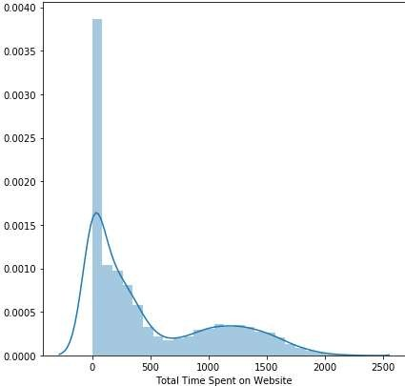
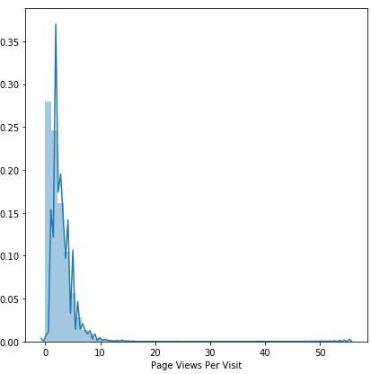
UNIVARIATE ANALYSIS
EDA

Slide 6
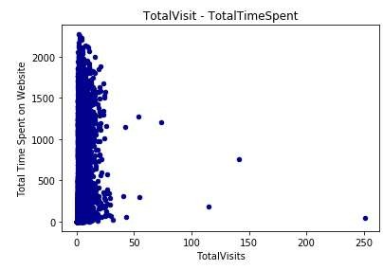
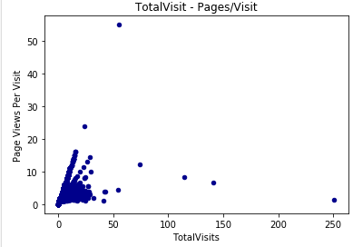
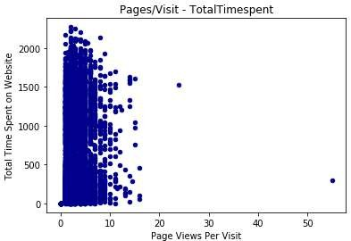
BIVARIATE ANALSYIS

Slide 7
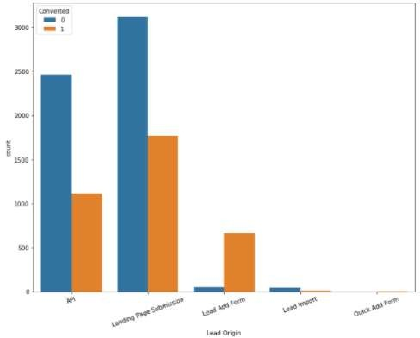
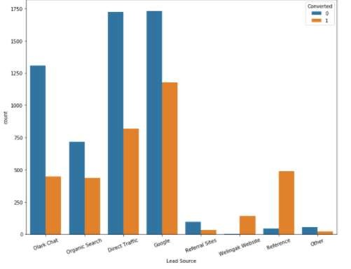
CONVERSION RATE WITH CATEGORICAL VARIABLES
In lead origin, more conversions are present in Landing Page Submission category. In Lead
Source more 1’s (conversions) are present in the level Google, followed by Direct Traffic.

Slide 8
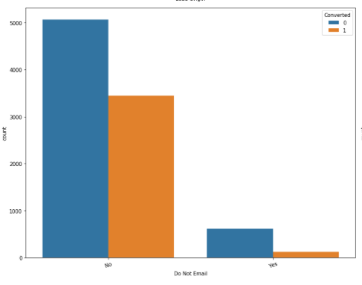
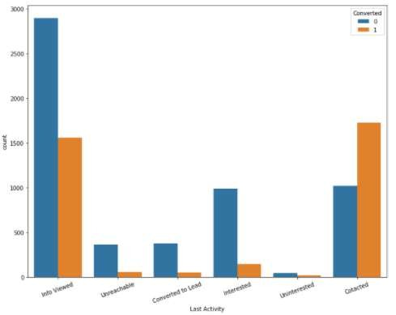
Maximum people choose not to receive e-mails. The percentage of those who choose to
receive e-mails, is more in the level 0 (no conversion)

Slide 9
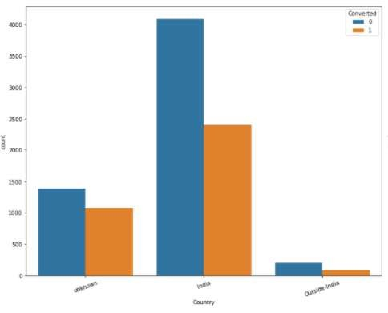
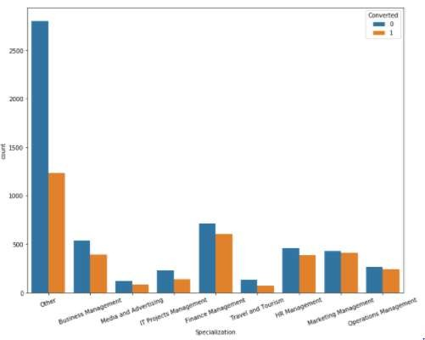
Most leads are present in India, with few percentage outside, and the rest unknown. Among the
known categories in Specialization, IT Projects Management has the maximum presence.

Slide 10
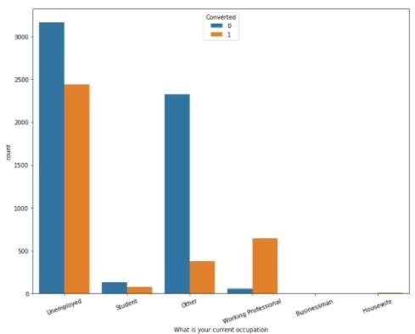
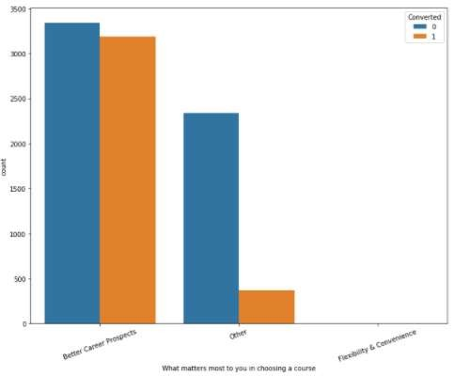
Most people/’probable leads’ are unemployed and a lot of them are looking for better
career prospects.

Slide 11
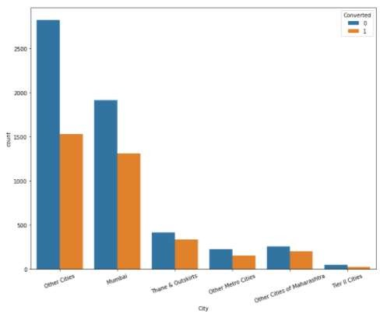
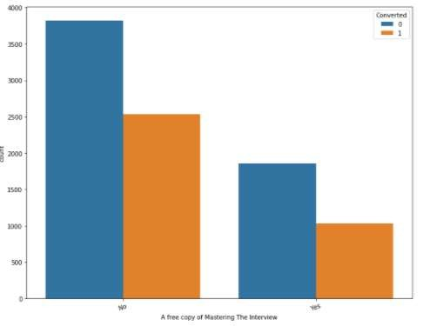
Among the known categories, Mumbai has the maximum percentage of ‘probable leads’, while tier-two cities has the least. Most people choose not to receive ‘A free copy of mastering the interview’

Slide 12
DATA PREPARATION
Dummy Variable creation
The binomial categorical variable Yes/No is mapped to 1/0
Dummy Variables were created and the level of dummy variable level which is l east significant is dropped , also original columns are dropped since dummy variables are created
Data Splitting
Splitting of data into train and test data
Feature Scaling
The original numeric variables are scaled with Standard scaler method

Slide 13
MODELING OF THE DATA
 Build a basic model with all the features
 Using of RFE to select the features (limit number of variables =15)
 Dropping the variables which have p value > 0.05 and check the VIF value ,
dropping the columns which have VIF value > 5
 Checking the accuracy of the model our model has the accuracy of 76.3% on the
training data.
 Checking the sensitivity and specificity of the train data with low threshold of 0.5
and 0.8
 The same steps were performed on the test data

Slide 14
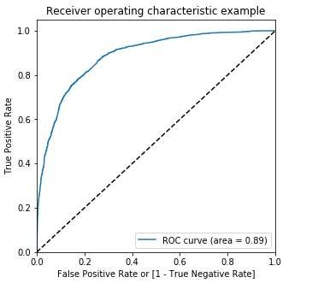
ROC CURVE FOR THE MODEL
The ROC curve is used to check the usefulness of the model. Here the graph is plotted against the predicted target variable and the probability
For the model Area under the curve = 0.89

Slide 15
METRICS MORE THAN ACCURACY
 Overall Accuracy : 81%
 Sensitivity : 77%
 Specificity : 44%
 From the predictions made on the test set, a conversion rate of 40 percent was obtained with a sensitivity of 77 percent-i.e out of those predicted as ‘hot leads’ by the model, 77 percent actually converted to leads- very near to the figure of 80 percent required by the CEO. Also, the specificity on the test set obtained was 84 percent- that is the model is able to predict with higher detail as whom not to pursue during crunch time. Hence for meeting deadlines, we need to set a probability level which can give us high sensitivity (whom to pursue as lead) and also high specificity (whom not to pursue as lead). The conundrum lies in the trade off where sensitivity decreases with a high probability threshold, but specificity increases with a higher probability threshold. Hence the recommended threshold is 0.6 as a trade-off level between the two

Slide 16
METRICS MORE THAN ACCURACY
The team must concentrate most on below features so that they can make pursue
hot leads and increase the conversion rate
What is your current occupation_Working Professional
When the Lead Origin is Lead Add Form
Lead Source_Welingak Website
What matters most to you in choosing a course_Better Career Prospects
Last Activity_Contacted
Total Time Spent on Website

Slide 17
THANK YOU

